Slide 1



Slide 2



Slide 3


Slide 4



Slide 5


Slide 6


Slide 7



Slide 8


Slide 9



















Slide 10




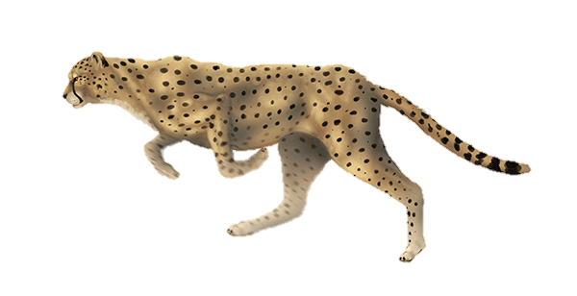

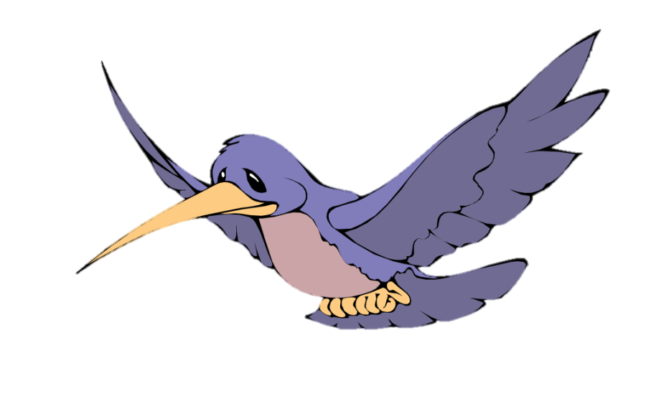

Slide 11



Slide 12
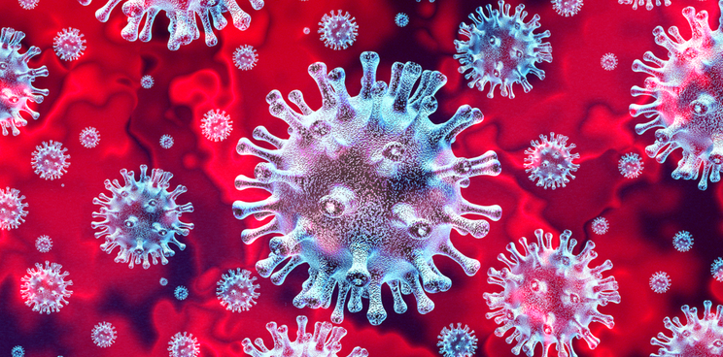



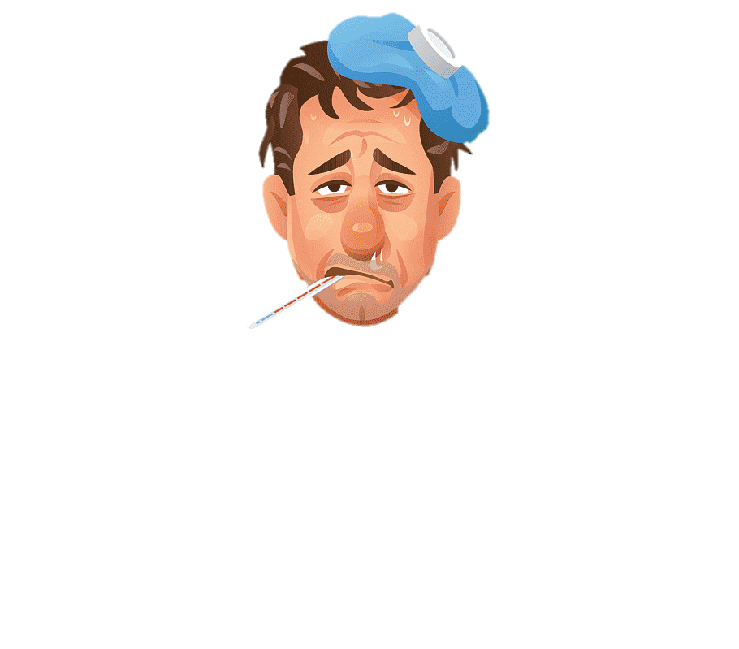

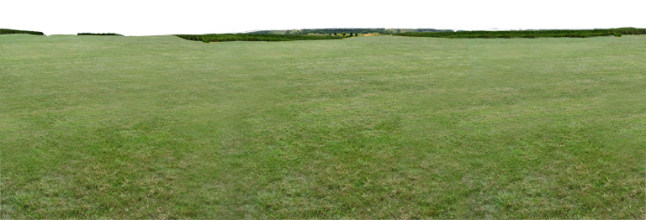
CONGRATS!!!
You’re at home now!
Stay Home…
Stay Safe…
GAME OVER!!!
You’re corona infected now… Turn your head
To restart the game

Slide 13



Slide 14


Slide 15
You are now having sanitizer protection, now the virus can’t infect you unless sanitizer is over.
You are now having sanitizer protection, now the virus can’t infect you unless sanitizer is over.
You are now having sanitizer protection, now the virus can’t infect you unless sanitizer is over.

Slide 16
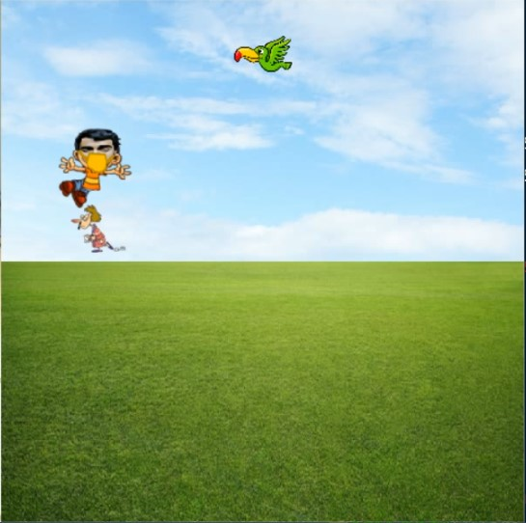
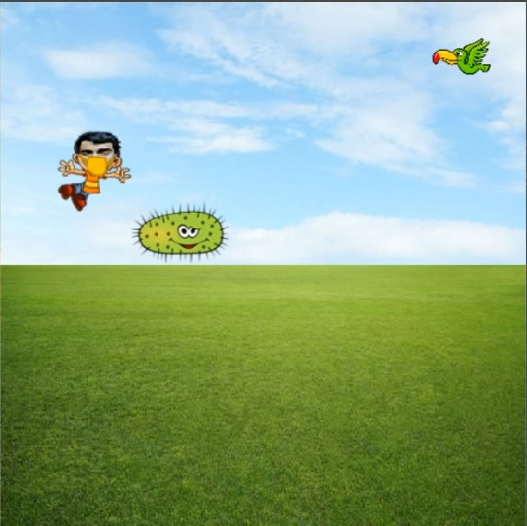


Slide 17
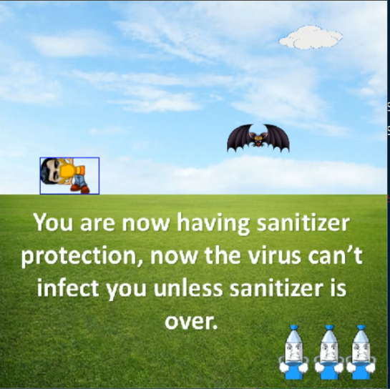

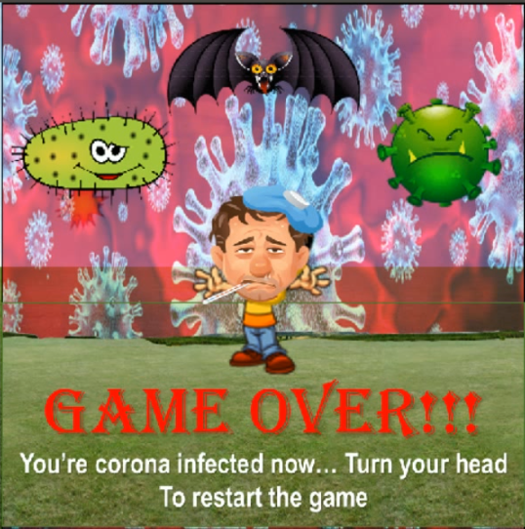

Slide 18

Do Nothing

Slide 19

Character Jumps
Jump High

Slide 20

Character Crouches
Crouch Looking at Camera

Slide 21

Character Jumps after crouch
Abruptly standing

